Slide 1
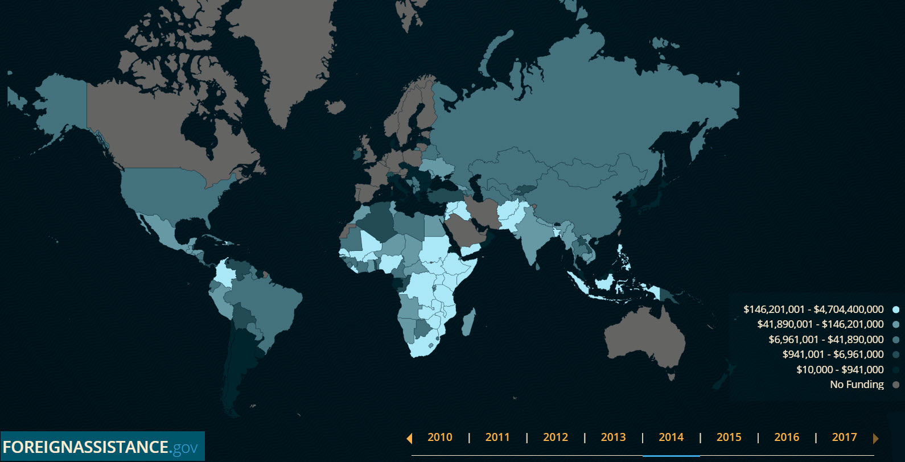
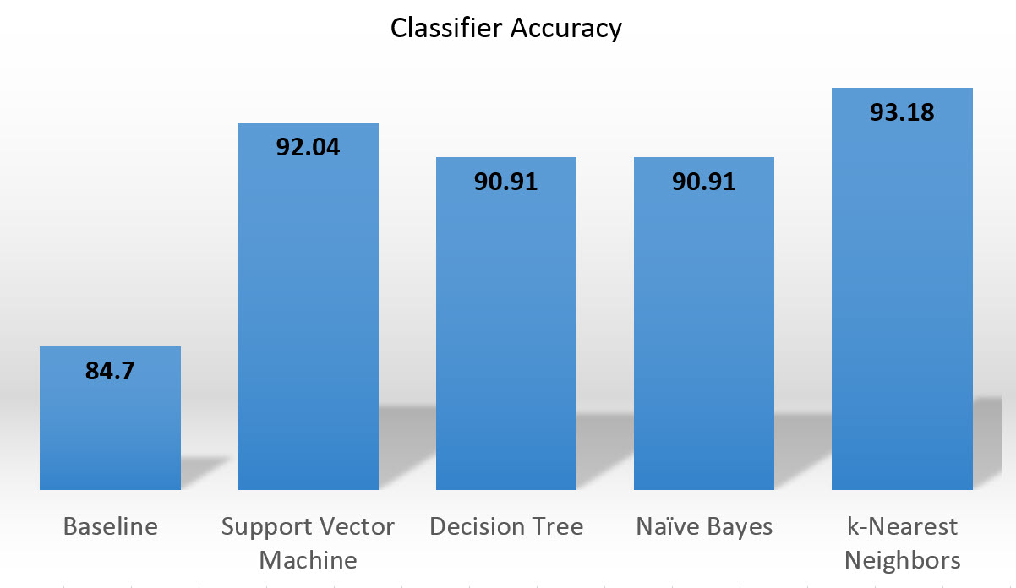
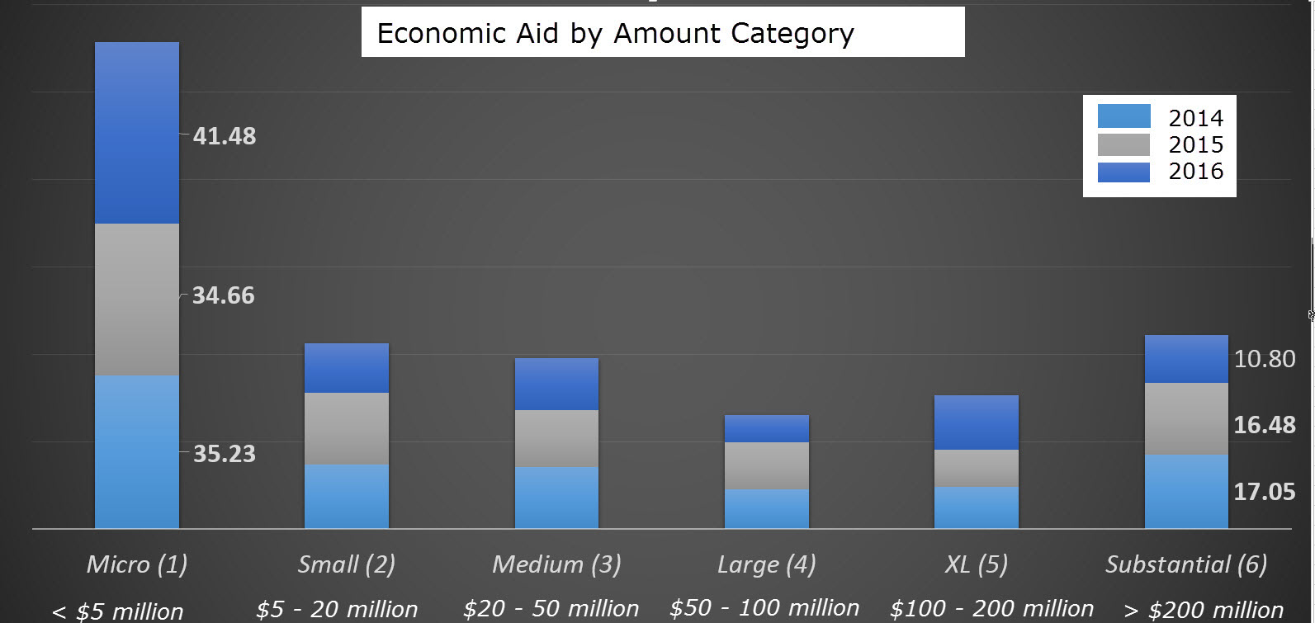

Show Me the Money: Forecasting Economic Aid
with Machine Learning
By : Laura Kahn and Majid Khorrami, Indiana University
ABSTRACT
METHODS
RESULTS
Foreign assistance promotes America’s interests, improves lives abroad and achieves the United Nation’s Sustainable Development Goals.
What if decision makers could use data science techniques to predict how much aid they would receive?
Countries can plan for the future by forecasting aid amounts.
Aid amount was chosen as the feature. Linear regression was tested but the aid values were too varied from year to year to predict the exact dollar amount with any accuracy.
Since predicting the exact dollar amount was not feasible, each aid amount was given a category: Micro (< $5 million), Small ($5 – $20 million), Medium ($20 - $50 million), Large ($50 -$100 million), XL ($100 - $200 million) and Substantial (> $200 million).
Each category was encoded with numbers 1 - 6.
Naïve Bayes, Decision Tree, Support Vector Machine and K-Nearest Neighbors machine learning algorithms were used to predict amount categories for 2014 - 2016.
There were 16 countries (9.1%) where classifiers didn’t predict aid category. For these countries, there was an average disbursement difference of $96.5 million.
The classifier using 2014-2015 data had the highest baseline accuracy of 84.7%. All classifiers outperformed the baseline accuracy by at least 7%. K-Nearest Neighbors had the highest accuracy of 93.18%.
ForeignAssistance.gov map, 2014
Machine Learning Classifier Accuracy
BACKGROUND
CONCLUSION
Economic aid disbursement amounts from the U.S. Agency for International Development from 2014 to 2016 for 176 countries were extracted from explorer.usaid.gov. Economic aid is for programs with a development or humanitarian objective.
The hypothesis of whether foreign economic aid disbursements can be predicted was tested.
The largest percentage of aid disbursements were “Micro."
Countries can use machine learning to predict funding for development or humanitarian programs to support the Sustainable Development Goals.

